Slide 1
Advanced Estate Planning
November 10, 2015
San Francisco Paralegal Association
Presented by:
David B. Gaw & Jackie Patterson, JD, MBT, CPA

Slide 2
Beyond the Basics
ILITS for Life Insurance
Charitable Remainder Trust (CRAT/CRUT)
Charitable Lead Trust (CLAT/CLUT)

Slide 3
Beyond the Basics (cont’d)
Private Foundations
Donor Advised Funds at Community Foundation
Private Annuity
Conservation Easements

Slide 4
Beyond the Basics (cont’d)
Division of assets into different entities for asset protection and planning
Intentionally Defective Beneficiary Trusts (IDBT)

Slide 5
Most Common Advanced Techniques
Qualified Personal Resident Trust (QPRT)
Grantor Retained Annuity Trust (GRAT)
Intentionally Defective Grantor Trust (IDGT) (with or without SCIN)
Irrevocable trust on back-end of all plans
Stand-Alone Irrevocable Trust for Annual Exclusion Gifting

Slide 6
QPRTS
6

Slide 7
Explaining QPRTS to your Clients
Gift of a $1 million outright
Gift of a $1 million, but cannot benefit until 20 years later

Slide 8
The Discounts of QPRTS
Fractional interest discount for using multiple QPRTs
Discount for retained income interest (essentially time value of money)
Discount for contingent reversion if grantor does not live the term

Slide 9
Demonstration of QPRT (Estate Planning Tools)

Slide 10
Issues for QPRTs
Must live out the term of the QPRT
Compare capital gains tax savings vs. estate tax savings
The older the client, the better
Explain ETIP rules to client and use for only for non-skip beneficiaries (or apply GST on back-end if skip beneficiaries)

Slide 11
Issues for QPRTs (cont’d)
Role of Section 7520 rate (at creation, the higher the better)
Quit paying rent to ensure estate inclusion (step-up)
Would transfer to IDGT be preferable?

Slide 12
The Principal Residence
Used as principal residence
Can include large parcel, where non-divisible
Can have some commercial use
Can be trailer or boat or yacht

Slide 13
The Non-Principal Residence
The Vacation Home
Can be rented out, but grantor must use it for the greater of 14 or more days per year or 10% of the days rented
Possibly two vacation homes, if:
Husband and wife QPRT the principal residence
Transfer respective homes to the husband and wife as their separate property
Easiest “sale” of all QPRTs since frequently want to keep it in the family

Slide 14
What if …
Sale of the house during term of QPRT?
If you do purchase new house within 2 years before or after sale of residence, the QPRT can still qualify
If you do not purchase house within 2 years, converts to GRAT

Slide 15
Work After Signing
Prepare gift tax return
Calendar Termination Dates
Prepare rental agreement (after QPRT term) or determine whether no rent is desired (to include in estate)
Terminate the trust
If beneficiary dies during term, need to revise estate plan

Slide 16
GRATS
16

Slide 17
EXPLANATION TO CLIENTS
2 Year GRAT
$1million property
$500,000 annuity
No increase in value
Results in entire property transferred back to Grantor

Slide 18
Same GRAT
But increases in value to $2 million immediately
Half of property comes back to Grantor
Remaining half distributed pursuant to GRAT back end terms

Slide 19
Basics of GRATS
Grantor Trustee During Term
Grantor Gets Back Original Asset Value + 7520 Rate (rest remains in trust)
Must Live Term
Multiple GRATs for discounts and spreading risk
Role of Section 7520 rate (the lower the better)

Slide 20
Basics of GRATS (cont’d)
ETIP Issues
Type of Assets
Fixed vs. Variable (120% of previous year)
Income Tax Consequences
Adjustment of Annuity if IRS disputes value
What if Grantor dies before term expires

Slide 21
Basics of GRATS (cont’d)
Income Tax Consequences
Adjustment of Annuity if IRS Challenges Value
What if Grantor dies before term expires

Slide 22
Term of GRAT
Rolling GRATs
Zeroed Out/WALTON GRAT
10 Year GRATs
Qualifying for Marital Deduction
At termination, transfer to Non-skip persons or allocate GST and transfer to IDGT

Slide 23
When to Use a GRAT
Simplicity is Key
Little of no exemption left
Rolling GRATs available
GST is not a consideration

Slide 24
GRATs RUNNING THE NUMBERS
Demonstration

Slide 25
IDGTS
25

Slide 26
Why IDGTs are so Valuable
Freeze value of estate
All appreciation occurs outside estate
Payment of income tax reduces the value of estate
Payment of income tax is a tax-free gift to trust
Potential unlimited leveraging of GST exemption

Slide 27
Why IDGTs are so Valuable (cont’d)
Maximum control of cash flow through modeling
Incredible flexibility, can adjust cash flow during operation
No survival requirement

Slide 28
Why IDGTs are so Valuable (cont’d)
The sale to an IDGT moves appreciating assets from the grantor’s estate and replaces it with a depreciating note.
Even if there is no appreciation, the act of the sale exchanges a static asset with a depreciating asset, thus reducing the estate
Payment of the exact same income taxes you would pay otherwise to the extent it pays down principal will reduce your estate.

Slide 29
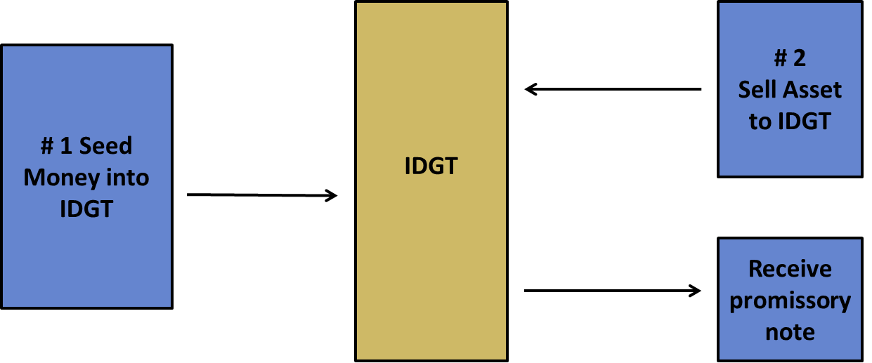
Explain the IDGT Basics to Clients

Slide 30
Demonstration: IDGT Modeling
Modeling is the key to IDGTs –Exhibit 1
Variables
Asset Value
Discounts
Gift Amount / Sale Amount
Growth of Asset Value
Growth of Cash Flows
Interest Rate
Amount of Principal to Pay Down Note
Amount of Principal to Beneficiary
Tax Rates

Slide 31
Details of IDGTs
Key Provisions
Funding
Pre-drafting and Post-drafting work
Exhibit 2 for key elements of IDGT transaction

Slide 32
Use of Guarantee in lieu of 10% Seed
Guarantee eliminates use of exemption for seeding, thereby retaining exemption for other use. Exhibit 3.
Beneficiary Guarantees
IDGT
Grantor
sells assets in exchange for promissory note
Guarantor
Gives Guaranty securing promissory note in exchange for guaranty fees

Slide 33
GVM’s Most Common Spousal IDGT
IDGT for only one spouse with sale.
Modeling what is gifted vs. sold
Interest rate on IDGT often is greater than AFR

Slide 34
GVM’s Most Common Spousal IDGT
Frequently little or no discount is preferred in transaction
Key is maintaining grantor spouse’s cash flow
Financial planning and structure of transaction
Modeling term of note

Slide 35
SCIN
Self Cancelling Installment Note
Demonstration
Recent PLR 201330033 – “SCIN signed by family members is presumed to be a gift and not a bona fide transaction.”
Required affirmative showing that at the time of the transaction “a real expectation of repayment and intent to enforce the collection of the indebtedness.

Slide 36
Defined Value Clause
Wandry Clause, Exhibit 4

Slide 37
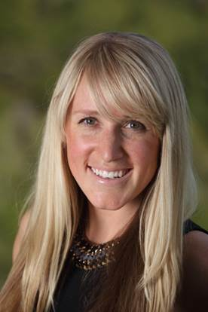
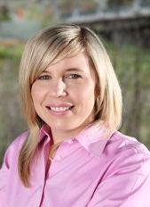
GVM Wealth Preservation Team
Dave Gaw
Jamie Watson
Jeff Stephens
Elizabeth Serres
Liz Conemac
Laura Srebro
Gaw Van Male
Wealth Preservation Team
1000 Main Street, 3rd Floor
Napa, CA 94559
707-252-9000
dave@gawvanmale.com

